Slide 1
Trading Algorithms
INTRODUCTION TO TECHNICAL ANALYSIS
Lecturer: Reza Entezari-Maleki entezari@iust.ac.ir
School of Computer Engineering
Iran University of Science and Technology

Slide 2
Outlines
Introduction
Price charts
Candlestick patterns
Support and resistance
Technical indicators
Moving Average (MA)
Volume
Moving Average Convergence/Divergence (MACD)
Relative Strength Index (RSI)
Ichimoku Cloud
How to work with TradingView

Slide 3
Introduction
In finance, technical analysis is an analysis methodology for analyzing and forecasting the direction of prices through the study of past market data.
Unlike fundamental analysis, which attempts to evaluate a security's value based on business results such as sales and earnings, technical analysis focuses on the study of price and volume.
The theory behind the validity of technical analysis is the notion that the collective actions – buying and selling – of all the participants in the market accurately reflect all relevant information pertaining to a traded security, and therefore, continually assign a fair market value to the security.
Technical traders believe that current or past price action in the market is the most reliable indicator of future price action.
Notes:
تکنیکال: تحلیلیه که جهت قیمت رو میخواد براساس گذشته بازار پیش‌بینی کند.
فاندامنتال یا تحلیل بنیادی: با داده گذشته کار ندارم و جهت قیمت آینده با موارد بنیادی انجام میگیرد. مثل یک کشور با سایر کشورها، تورم، تعویض هیئت مدیره شرکت و ...
تئوری پشت تکنیکال: در تکنیکال اعتقاد داریم گذشته بازار مهمه و فاندامنتال هم مهمه ولی در تکنیکال اگه فاند مهمه، خودش رو توی روند قیمتی گذشته نشون داده. در نتیجه در تکنیکال هم میتونیم فاند رو در نظر بگیریم. چون فاند اثرش رو روی نمودار میذاره.
مشکل اساسی تکنیکال: نیوز رو نمیتونه کپچر کنه چون خیلی سریع اتفاق میفته.
بازار گاهی تکراری میشود و ممکنه اتفاقی که الان میفته 10 سال قبل هم اتفاق افتاده باشه و در deep و کدزنی هم میشه از این استفاده کرد. عینا همون اتفاق نمیفته ولی مشابهه.

Slide 4
Introduction …
A core principle of technical analysis is that a market's price reflects all relevant information impacting that market.
A technical analyst therefore looks at the history of a security or commodity's trading pattern rather than external drivers such as economic, fundamental and news events.
It is believed that price action tends to repeat itself due to the collective, patterned behavior of investors.
Technical analysis most commonly applies to price changes, but some analysts track numbers other than just price, such as trading volume or open interest figures.
The two primary variables for technical analysis are the time frames considered and the particular technical indicators that a trader chooses to utilize.
Notes:
Time frame: مدت زمانی که یک قیمت رو بررسی میکنیم.

Slide 5
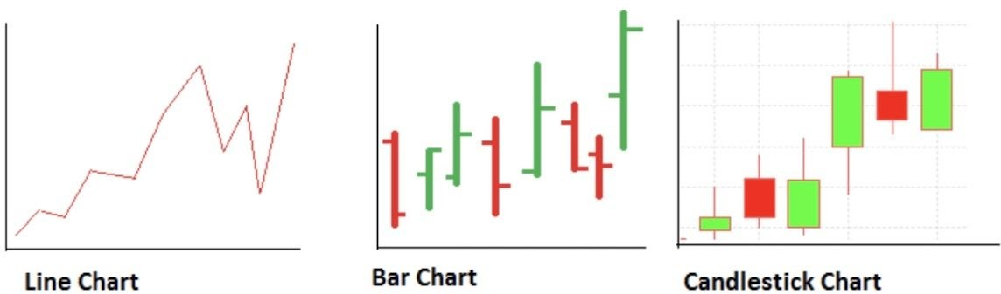
Price charts
Technical analysts use a variety of charts based on the information they seek. However, there are three types of charts that are most commonly used.
o Line
o Bar
o Candlestick
Notes:
قیمت در یک بازه زمانی را با open, close, high, low نشون میدیم. یا ohlc

Slide 6
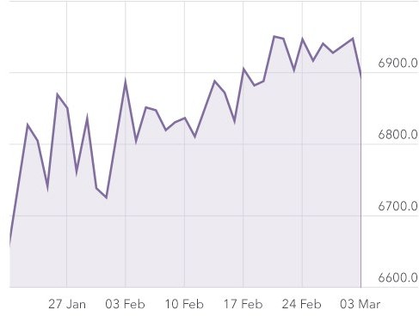
Price charts …
Line Chart
oIt plots the closing (or hlc3) price of a share for each trading day (time frame) over a period.
oThe line formed by joining the dots plotted on the graph shows the movements in stock price during the period.
Notes:
در اینجا رایجه که close رو نمایش میدن.
چیز دیگه‌ای هم که نمایش میدن (high + low + close)/3 عه که خروجیش خیلی شبیه به close هست.

Slide 7
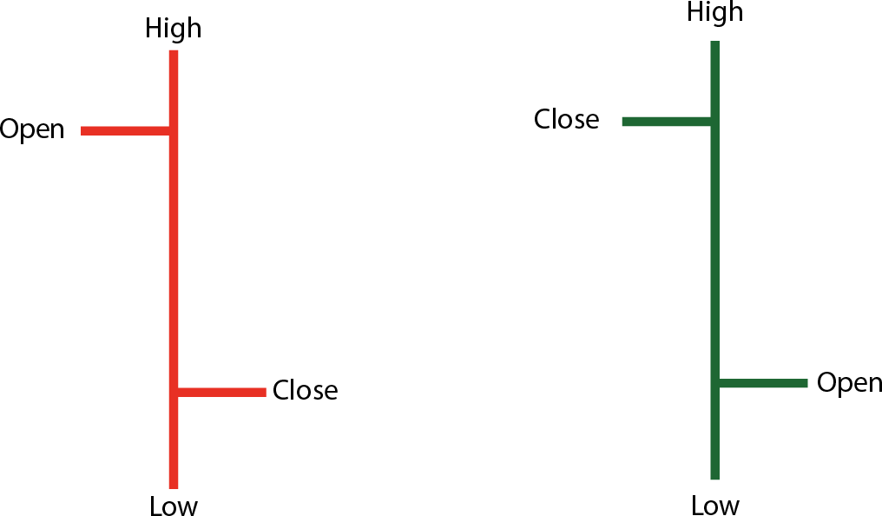
Price charts …
Bar Chart
It plots the high and low prices of a stock using a bar for each trading day for a specified time period.
The top of the bar corresponds to the day’s (time frame’s) high and the bottom, day’s low.
Two additional horizontal lines indicate the opening and closing price. The length of the bar is proportional to the volatility in a stock.
Colored coded - If the share price closes above the open price it is colored green, and if the close is below the open the bar is colored red.
Notes:
سبر: صعودی قرمز: نزولی حواست به جهت هم باشه.

Slide 8
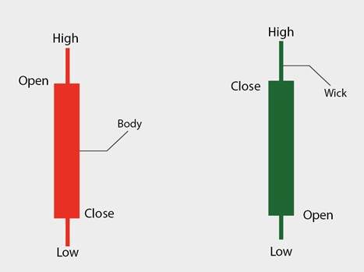
Price charts …
Candlestick chart
It displays the relationship between the high & low and opening & closing prices of a stock.
The body of the candle represents the opening and closing prices during the period.
Above and below the body are vertical lines called wicks or shadows that show the lows and highs of the traded prices.
While an individual candle provides sufficient information, patterns can be determined only by comparing one candle with its preceding and next candles.
Notes:
نمودار شمعی
بازارهایی که احساسات تاثیر داشته باشه، فاصله low و high بیشتره. و تو این بازارها اگه واقعا خبر مثبت باشه بدنش هم بزرگ میشه در غیر این صورت فقط shadow بزرگ میشه.

Slide 9
Candlestick patterns
Candlestick charts are a technical tool that packs data for multiple time frames into single price bars.
This makes them more useful than traditional open, high, low, close (OHLC) bars or simple lines that connect the dots of closing prices.
Candlesticks build patterns that may predict price direction once completed.
Proper color coding adds depth to this colorful technical tool, which dates back to 18th century Japanese rice traders.
Traditionally, candlesticks are best used on a daily basis, the idea being that each candle captures a full day’s worth of news, data, and price action.
This suggests that candles are more useful to longer-term or swing traders.

Slide 10
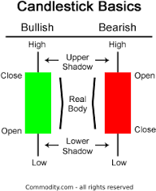
Candlestick patterns …
Candlestick charts are an effective way of visualizing price movements.
There are two basic candlesticks:
o Bullish Candle: When the close is higher than the open (usually green or white)
o Bearish Candle: When the close is lower than the open (usually red or black)
Notes:
وقتی که بازار سبز باشه bullish عه بخاطر اینکه گاو درحال حمله بالا میزنه و اونور چون خرس پایین میزنه میشه نزولی و قرمز.

Slide 11
Candlestick patterns …
Candlestick Charts is with multiple candlesticks forming reversal and continuation patterns.
o Bullish Engulfing
o Bearish Engulfing
o Hanging Man
o Harami
o Dark Cloud Cover
o Doji
o Dragonfly Doji
o Gravestone Doji
o Evening Star
o Morning Star
o Hammer
o Inverted Hammer
o Piercing Line
o Shooting Star
Notes:
ترکیب کندل‌ها باهمو کنارهم پترن‌هایی رو میسازن.

Slide 12
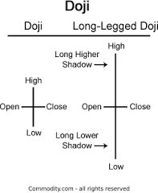
Doji
The open and close are very close together, creating a very small body Doji.
It represent indecision between the bulls and the bears.
A long-legged Doji is the same as Doji, except the upper and lower shadows shadows are much longer than the regular Doji formation.
Notes:
دوجی یا نامفهوم:

Slide 13
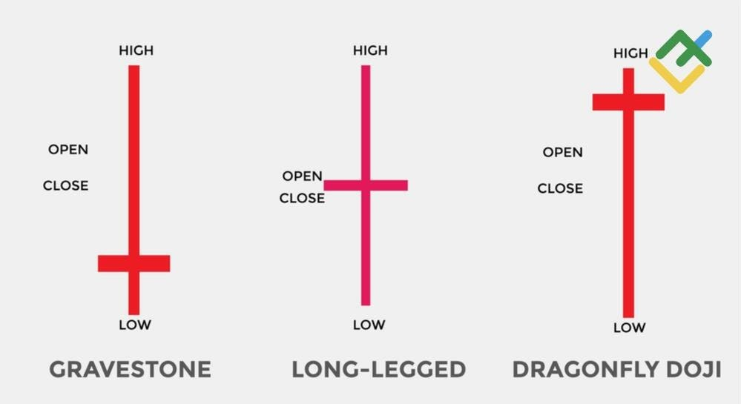
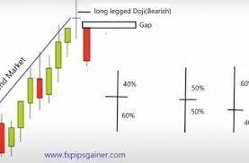
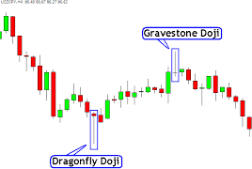
Doji …
Notes:
اگه Drigonfly Doji ته یک روند نزولی باشه احتمال اینکه بره بالا زیاده و اگه Gravestone Doji در سقف داشته باشیم (فشار فروش زیاد شده باشه) احتمال اینکه بیفته خیلی زیاده.

Slide 14
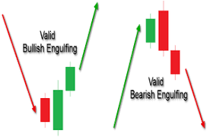
Engulfing
Engulfing patterns have one bearish and one bullish candle.
The second candle must fully cover the first candle.
Bullish or bearish, according to the second candle.
Notes:
اگه کنار یک کندل، یک کندل دیگر با رنگ دیگر شکل بگیرد که کندل قبلی کامل داخل بدنه کندل بعدی باشد. ؟؟؟
اگه ته روند نزولی باشه، امید برای صعود میده و بالعکس.

Slide 15
Support and resistance
Support and resistance are two foundational concepts in technical analysis.
Understanding what these terms mean and their practical application is essential to correctly reading price charts.
Prices move because of supply and demand. When demand is greater than supply, prices rise. When supply is greater than demand, prices fall.
Sometimes, prices will move sideways as both supply and demand are in equilibrium.
Notes:
حرکت قیمت براساس عرضه و تقاضاست. وقتی تقاضا زیاده قیمت بالا میره و در جایی حس میشه که دارن گرون میخرن اونجا افت میکنه و پایین میاد تاجایی که اینقدر پایینه که جذب میشن بخرن که همین باعث افزایش قیمت میشه.
مقاومت‌ها: قیمت رفته بالا رفته بالا که به یه قیمت خورده که شروع به عرضه کردن که اونجا رو بهش مقاومت میگن.

Slide 16
Support and resistance …
In a downtrend, prices fall because there is an excess of supply over demand.
The lower prices go, the more attractive prices become to those waiting on the sidelines to buy the shares.
At some level, demand that would have been slowly increasing will rise to the level where it matches supply. At this point, prices will stop falling. This is support.
Support can be a price level on the chart or a price zone.
In any event, support is an area on a price chart that shows buyers’ willingness to buy.

Slide 17
Support and resistance …
Resistance is the opposite of support. Prices move up because there is more demand than supply.
As prices move higher, there will come a point when selling will overwhelm the desire to buy.
This happens for a variety of reasons. It could be that traders have determined that prices are too high or have met their target. It could be the reluctance of buyers to initiate new positions at such rich valuations. It could be for any other number of reasons.
But a technician will clearly see on a price chart a level at which supply begins to overwhelm demand.
This is resistance. Like support, it can be a level or a zone.

Slide 18
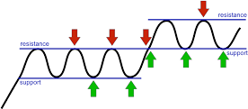
Support and resistance …
Support and resistance lines indicate likely end of trends.
Resistance results from the inability to surpass prior high.
Support results from the inability to break prior low.
If support has broken than that level become the resistance, and vice-versa.
Notes:
به فاصله بین support و resistance میگن کانال که تعدادش مهمه و تعداد این برگشت‌ها روی قدرت هرکدام موثر است. خود کانال تکنیکاله ولی اون نقطه‌ای که این روند عوض شده یا فاندامنتاله یا sentiment هست

Slide 19
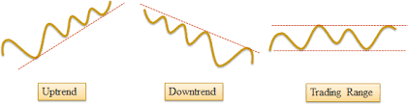
Trend Lines
There are three basic kinds of trends:
o An up trend where price are generally increasing.
o A down trend where price are generally decreasing.
o A trading range.
Notes:
یکی از چالش‌های نمودار لیبل زنیه. سختیش در تعداد کندل‌هایی است که باید برای شناسایی این مورد است.

Slide 20
Pivot points
A pivot point is a technical analysis indicator, or calculations, used to determine the overall trend of the market over different time frames.
The pivot point itself is simply the average of the intraday high and low, and the closing price from the previous trading day.
On the subsequent day, trading above the pivot point is thought to indicate ongoing bullish sentiment, while trading below the pivot point indicates bearish sentiment.
Pivot points are calculated to determine levels in which the sentiment of the market could change from bullish to bearish, and vice-versa.
Day traders calculate pivot points to determine levels of entry, stops, and profit-taking.
Notes:
یه سری فرمول‌ هستند که براساس high و low که در کندل وجود دارد، یه میانگین درنظر میگیره که فرمولش:
Close + high + low/3 هست.

Slide 21
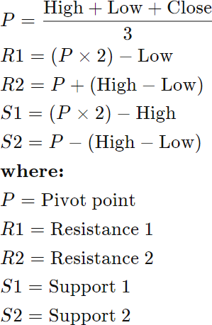
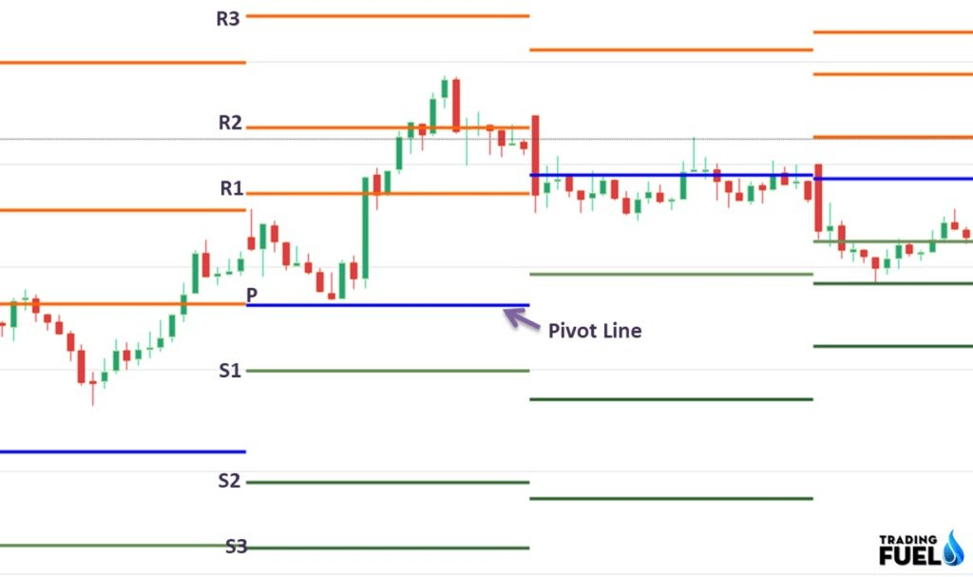
Pivot points …
Notes:
میبینن که قیمت امروز نسبت به close هفته قبل و high و low این هفته چه تغییری کرده و براساس اون تصمیم میگیرن.
از pivot و 4 نقطه دیگر برای خرید و فروش در زمان مناسب استفاده میکنیم.

Slide 22
Moving Average (MA)
A moving average (MA) is a stock indicator commonly used in technical analysis.
The reason for calculating the moving average of a stock is to help smooth out the price data by creating a constantly updated average price.
By calculating the moving average, the impacts of random, short-term fluctuations on the price of a stock over a specified time frame are mitigated.
Simple moving averages (SMAs) use a simple arithmetic average of prices over some timespan, while exponential moving averages (EMAs) place greater weight on more recent prices than older ones over the time period.
Notes:
شیب‌های زیاد معمولا ناشی از sentiment و اخبار هیجانی‌ست.
برای میانگین متحرک. وقتی در قیمت نوسان داریم، برای از بین بردن این نویزها از این استفاده میکنیم.
در این صورت میتوان random و short-term ها رو از بین ببریم. پیش‌بینی MA معمولا آسون‌تر از price و ... است. اهمیتش در اینه.
2 نوع ازش داریم:
1- SMA: از میانگین ساده به دست میاد که از میانگین 10 کندل گذشته را در نظر میگیریم و عموما closeش رو در نظر میگیرن. برای امروز 10 کندل میانگین به دست میاریم میشه قیمت امروز. برای دیروز هم به همین صورت و ...
2- EMA: هدف کندل‌هایی که اخیرا شکل گرفتن تاثیر بیشتری داشته باشند. در SMA تاثیر همه کندل‌های یکی بود ولی در EMA در واقع کندل امروز از دیروز مهمتر است.

Slide 23
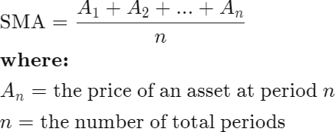
Moving Average (MA) …
A simple moving average (SMA), is calculated by taking the
arithmetic mean of a given set of values over a specified period.
A set of numbers, or prices of stocks, are added together and then divided by the number of prices in the set.
The formula for calculating the simple moving average of a security is as follows:
Notes:
Look back:
Andicator: فرمول‌های ریاضی هستند که یکسری اعداد جدیدی را روی price به ما میدهند و میتوان نمودارهای جدیدی به ما بدهند. مثلا pivot andicator است.

Slide 24
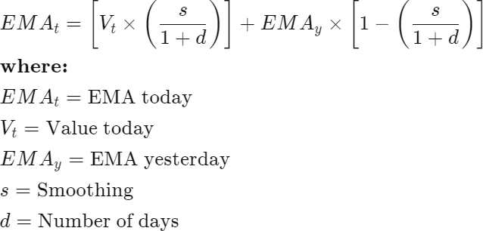
Moving Average (MA) …
The exponential moving average (EMA) gives more weight to recent prices in an attempt to make them more responsive to new information.
To calculate an EMA, the simple moving average (SMA) over a particular period is calculated first.
Then calculate the multiplier for weighting the EMA, known as the "smoothing factor," which typically follows the formula: [2/(selected time period + 1)].

Slide 25
Moving Average (MA) …
Moving averages are often used by technical analysts to keep track of price trends for specific securities.
An upward trend in a moving average might signify an upswing in the price or momentum of a security, while a downward trend would be seen as a sign of decline.
A golden cross is a chart pattern in which a short-term moving average crosses above a long-term moving average.
The golden cross is a bullish breakout pattern formed from a crossover involving a security's short-term moving average such as the 20-day moving average, breaking above its long-term moving average, such as the 50-day moving average.
Notes:
اگه short-term long-term رو رو به بالا بشکنه احتمالا رشد صعودی داریم و هر وقت رو به پایین قطع بکنه، نزول خواهیم داشت.
Look back: یعنی به چند کندل قبل اهمیت بده.

Slide 26
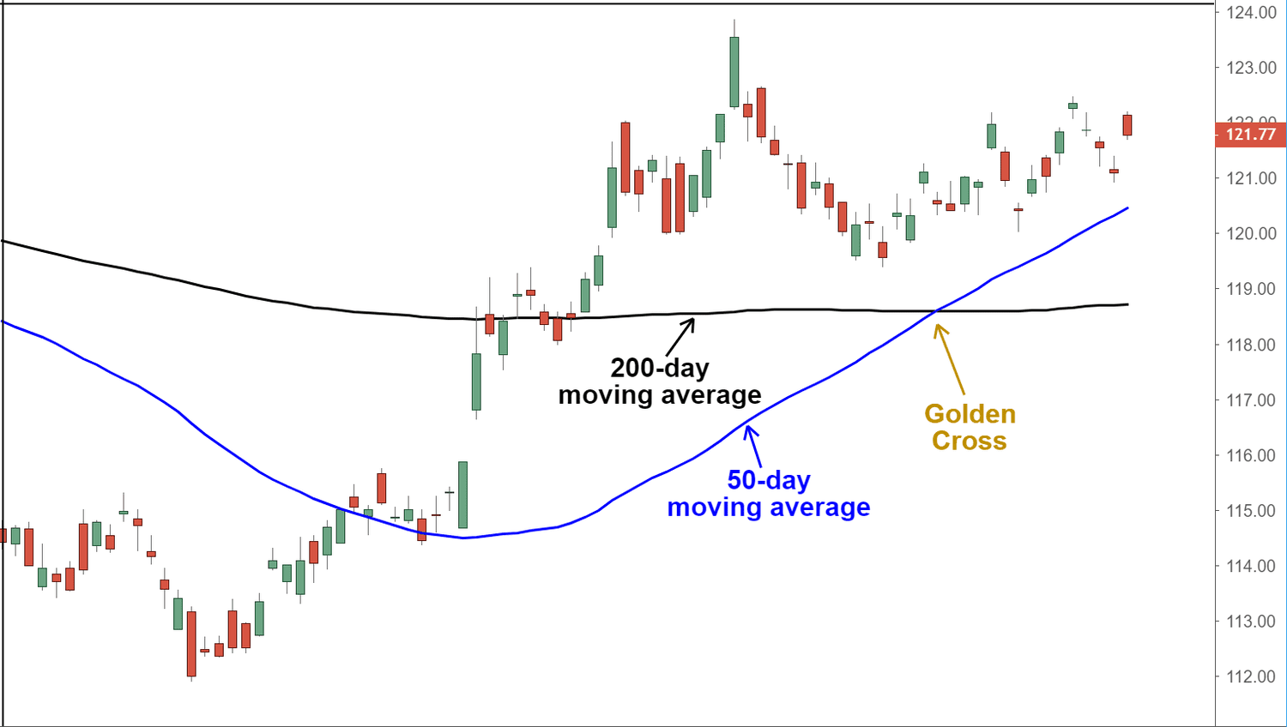
Moving Average (MA) …

Slide 27
Volume
Trading volume is a measure of how much a given financial asset has traded in a period of time.
Traders look to volume to determine liquidity and combine changes in volume with technical indicators to make trading decisions.
Volume can indicate market strength, as rising markets on increasing volume are typically viewed as strong and healthy.
When prices fall on increasing volume, the trend is gathering strength to the downside.
When prices reach new highs (or no lows) on decreasing volume, watch out—a reversal might be taking shape.
Notes:
حجم معاملات معیاری است از میزان معامله یک دارایی مالی معین در یک دوره زمانی. تعداد افرادی که معامله هم میکنن هم مهمه.
نقدشوندگی مهمه. به طور مثال مردم در binance معامله میکنن چون نقدشوندگی بیشتری دارد.
(Volume * قیمت سهم) را بهش کف میگن.

Slide 28
Volume …
Trend Confirmation
A rising market should see rising volume. Buyers require increasing numbers and increasing enthusiasm to keep pushing prices higher.
Increasing price and decreasing volume might suggest a lack of interest, and this is a warning of a potential reversal.
Volume and Price Reversals
After a long price move higher or lower, if the price begins to range with little price movement and heavy volume, then this might indicate that a reversal is underway, and prices will change direction.
Volume and Breakouts vs. False Breakouts
On the initial breakout from a range or other chart pattern, a rise in volume indicates strength in the move.
Little change in volume or declining volume on a breakout indicates a lack of interest and a higher probability for a false breakout.
Notes:
Volume بالاتر توی up trend، اونو تقویت میکنه و volume بالاتر توی downtrend اونو تقویت میکنه.
Volume پایین‌تر توی up trend، یعنی احتمالا قیمت داره برمیگرده و volume پایین‌تر توی downtrend یعنی احتمالا قیمت میخواد افزایش پیدا کنه.
Breakoutها: جایی که خطوط مقاومت و حمایت را میکشیدیم میگفتیم شکسته. اگه کندل خط را بکشند به آن breakout گویند. جایی که breakout ببینیم باید حجم بالایی خورده باشه. اگه دو یا سه کندل که یک خط را بشکند، حجم بالایی داشته باشند یعنی شکست واقعی بوده و اگر حجم کم بوده یعنی واقعی نبوده.

Slide 29
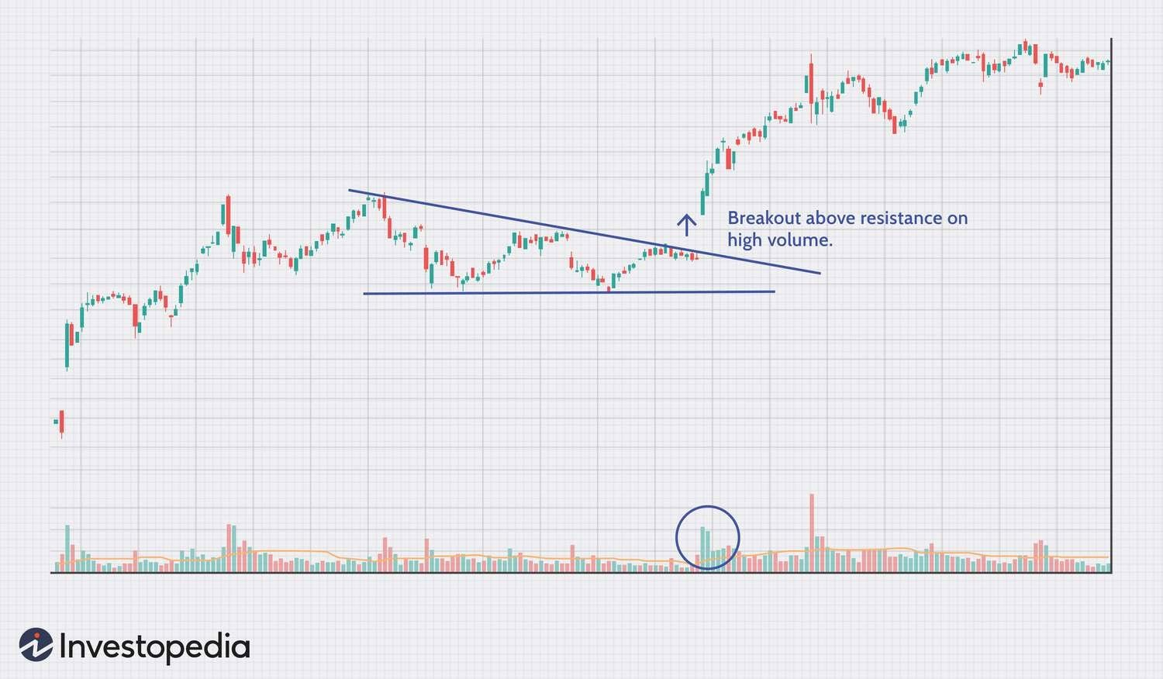
Volume …

Slide 30

Moving Average Convergence/Divergence (MACD)
The moving average convergence/divergence (MACD, or MAC-D) line is calculated by subtracting the 26-period exponential moving average (EMA) from the 12-period EMA.
The signal line is a nine-period EMA of the MACD line.
MACD is best used with daily periods, where the traditional settings of
26/12/9 days is the norm.
MACD triggers technical signals when the MACD line crosses above the signal line (to buy) or falls below it (to sell).
Notes:
دوتا EMA میگیریم یکی رو پریود 26 یکی رو 12. MACD دوتا خط داره. در واقع 12 و 26 Loop back عه که از تفاضلشون MACD پیدا میشه که چندتاشون باهم یک خط درست میکنن که از اون یک EMA9 میگیریم که اون signal line میشه.
اگه MACD signal line رو رو به بالا قطع بکنه ازش وایب خرید و اگر رو به پایین قطع بکنه ازش وایب فروش میگیریم.

Slide 31
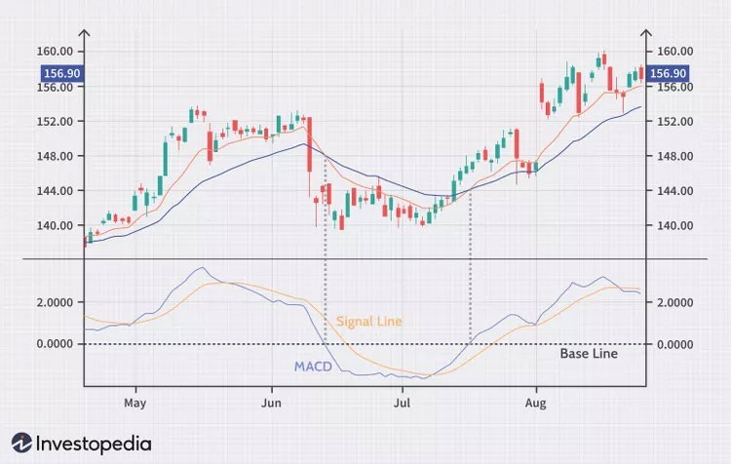
Moving Average Convergence/Divergence (MACD) …
MACD has a positive value whenever the 12-period EMA is above the 26-period EMA and a negative value when the 12-period EMA is below the 26-period EMA.
The level of distance that MACD is above or below its baseline indicates that the distance between the two EMAs is growing.

Slide 32
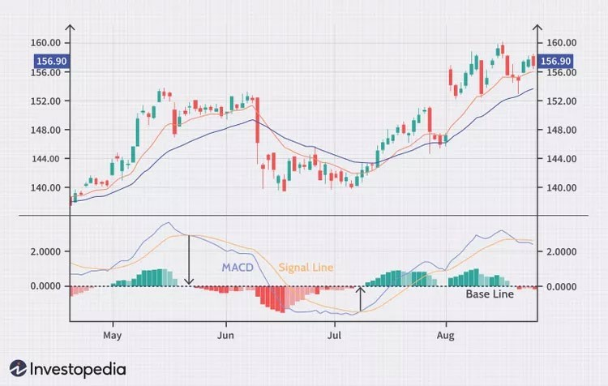
Moving Average Convergence/Divergence (MACD) …
MACD is often displayed with a histogram that graphs the distance between MACD and its signal line.
If MACD is above the signal line, the histogram will be above the MACD’s baseline, or zero line. If MACD is below its signal line, the histogram will be below the MACD’s baseline.
Traders use the MACD’s histogram to identify when bullish or bearish momentum is high—and possibly overbought/oversold.
Notes:
اگر MACD بالاتر از signal line باشه رنگ سبزه و در غیر این صورت قرمزه. مقدار بالا پایین شدن و تفاوت را با روشن یا تیره شدن رنگ سبز یا قرمز نشون میدن.

Slide 33
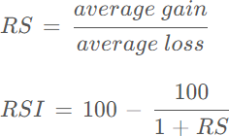
Relative Strength Index (RSI)
The relative strength index (RSI) is a momentum indicator used in technical analysis.
RSI measures the speed and magnitude of a security's recent price changes to evaluate overvalued or undervalued conditions in the price of that security.
As a momentum indicator, the relative strength index compares a security's strength on days when prices go up to its strength on days when prices go down.
The RSI uses a two-part calculation that starts with the following formula:
Notes:
Andicatorهایی که میزان شتاب صعودی و نزولی رو نشون میدن بهشون momentumی میگویند. در اونها سرعت و بزرگی تغییرات رو نشون میدن.
Average gain و average loss در یک تایم مشخص گرفته میشن.

Slide 34
Relative Strength Index (RSI)
The average gain or loss used in this calculation is the average percentage gain or loss during a look-back period.
The standard number of periods used to calculate the initial RSI value is 14.
The RSI can do more than point to overbought and oversold securities. It can also indicate securities that may be primed for a trend reversal or corrective pullback in price. It can signal when to buy and sell.
Traditionally, an RSI reading of 70 or above indicates an overbought situation. A reading of 30 or below indicates an oversold condition.
Notes:
کار RSI این است که یک Look back حساب میکنن که در اون میکشن که دوتا threshold مشخص میکنن که پیش فرض 30 و 70 عه و RSI یک عدد بین 0 و 100 عه. در واقع وقتی RSI از 70 بیشتر بشه یعنی رفته تو over bound شده یعنی بیش از حد خریدن و احتمالا ریزش داره. واسه 30 هم به همین صورت ولی برعکس. از andicator سیگنال خروج میگیرن نه ورود.
در بین 30 و 70 سیگنالی به ما نمیده ولی بعضیا دو خط 45 و 50 میکشن که به صورت مقاومت عمل میکنن. یه چیزی مثل support and resistance.

Slide 35
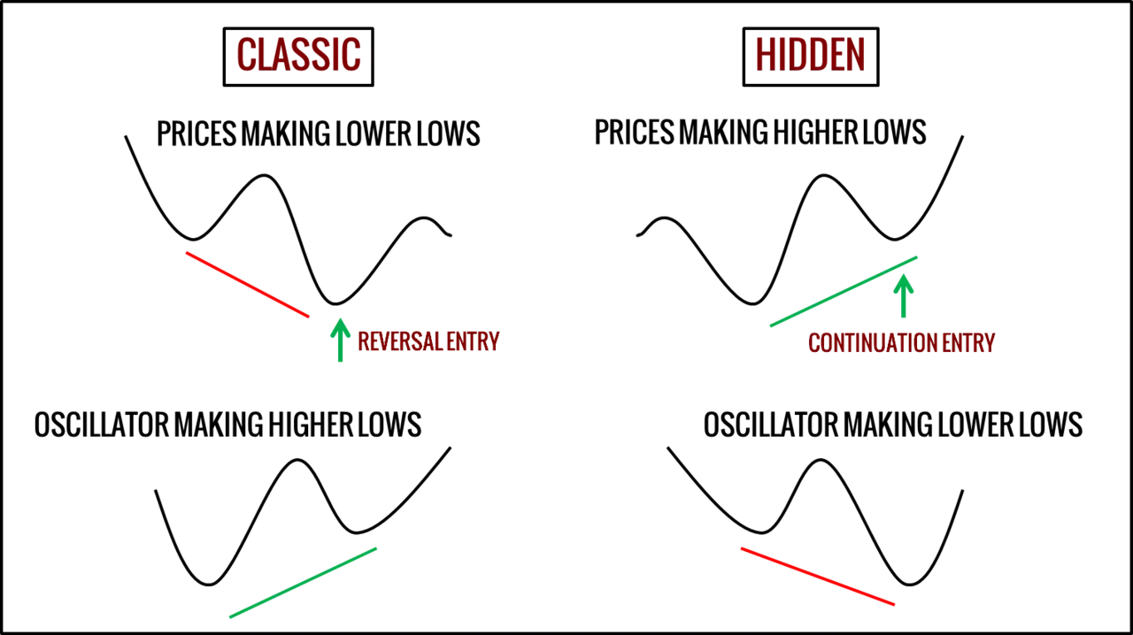
Regular and Hidden Divergence
Divergence is a technical analysis pattern spotted on price charts when the price of an asset is moving in the opposite direction of a technical indicator or moving contrary to other data.
Divergence is a warning that the current trend is weakening and may change.
Notes:
Andicatorهایی مثل MACD و RSI هستند بعضا واگرایی نشون میدن که دو نوع داره:
1- کلاسیک (معمولی): اگر روند قیمت نزولی بود، دوتا higher high به هم وصلشون میکنیم. در صورتی که روند indicator (مثلا MACD) صعودی باشه و Price نزولی باشد، یعنی اگر جهت شیبشون برابر نبود از این نوع است. در این نوع حرف andicator رو گوش می‌کنیم. کاربرد برای خروج از position.
2- Hidden: اگر روند نزولی بود دو تا lower low رو میگیرم و به هم وصلشون میکنیم. در صورتی که روند indicator (مثلا MACD) نزولی باشه و Price صعودی باشد، یعنی اگر جهت شیبشون برعکس باشه از این نوع است. در اینجا حرف قیمت رو گوش می‌کنیم. کاربرد برای ماندن در position.

Slide 36
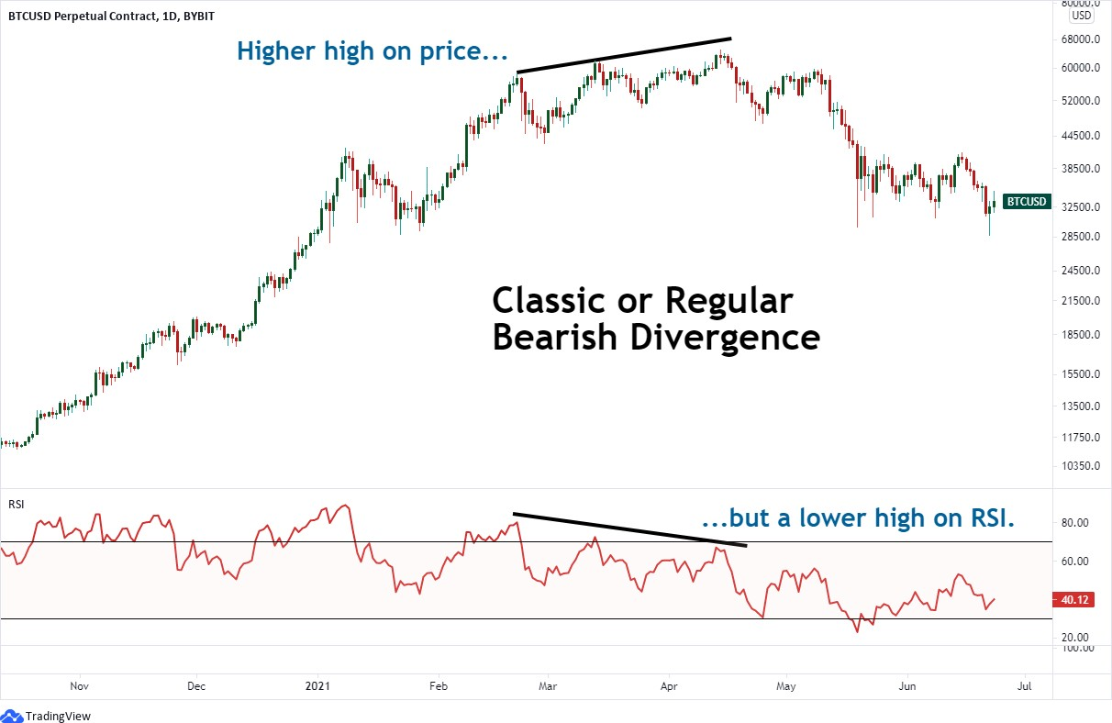
Regular and Hidden Divergence …
Regular or Classic Divergence (Bearish version)

Slide 37
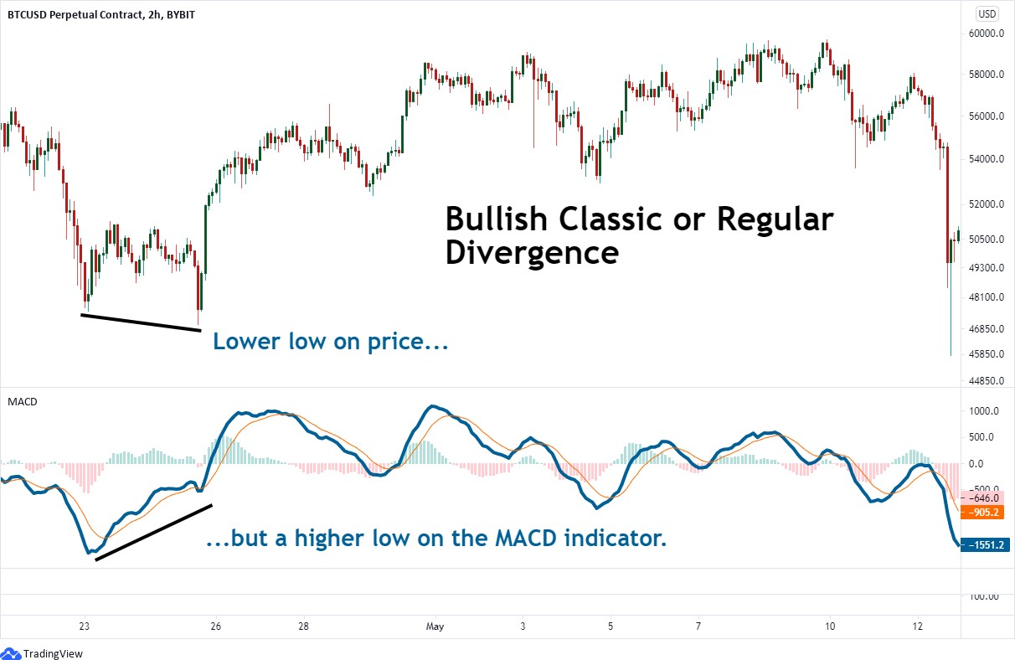
Regular and Hidden Divergence …
Regular or Classic Divergence (Bullish version)

Slide 38
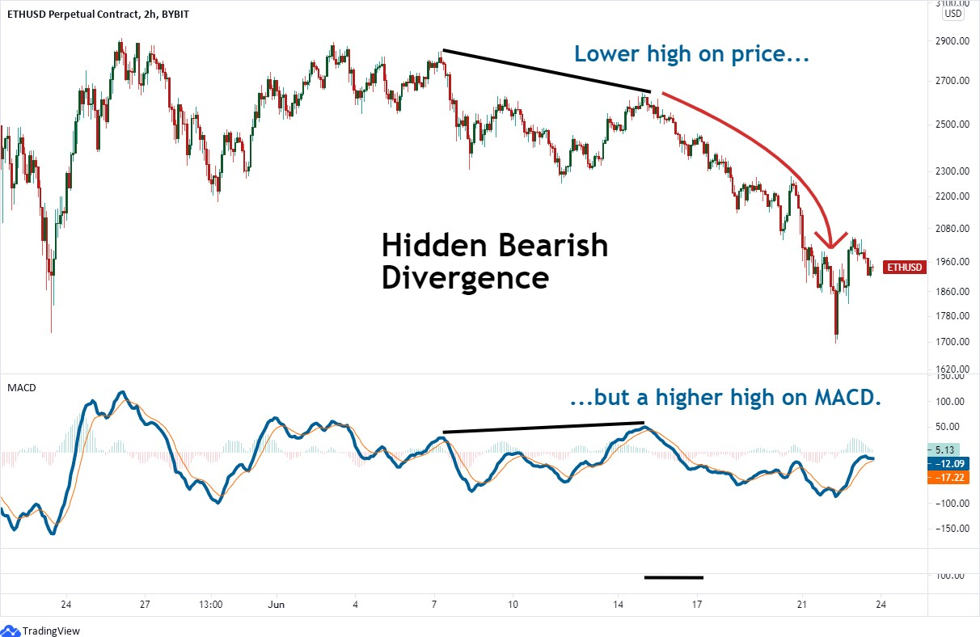
Regular and Hidden Divergence …
Hidden Divergence (Bearish version)

Slide 39
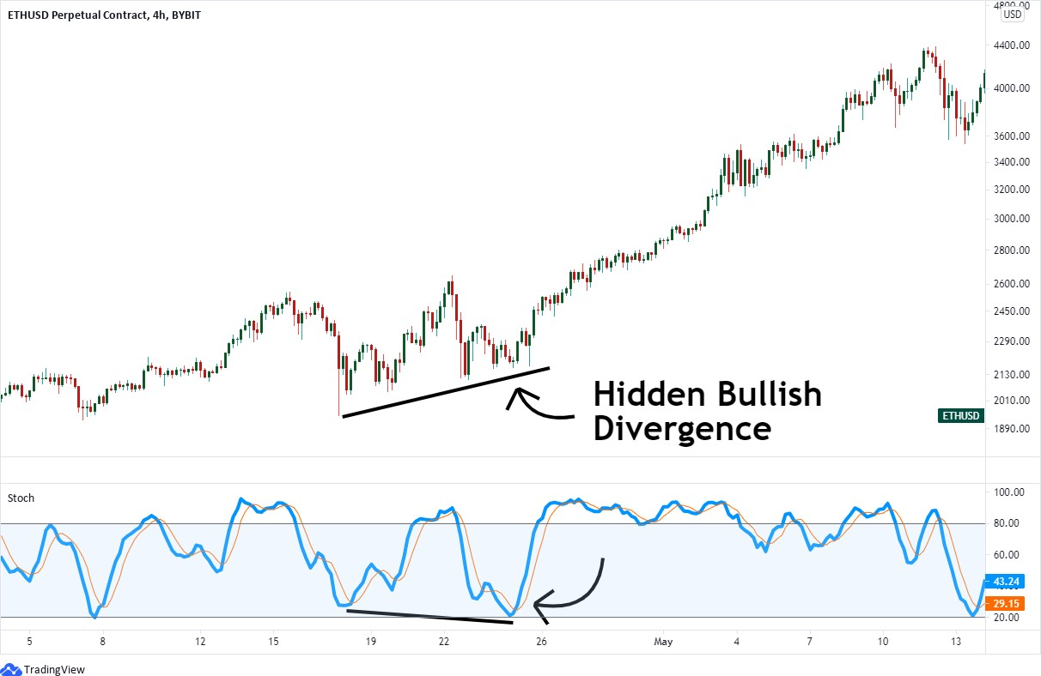
Regular and Hidden Divergence …
Hidden Divergence (Bullish version)

Slide 40
Ichimoku Cloud
The Ichimoku Cloud is a collection of technical indicators that show
support and resistance levels, as well as momentum and trend direction.
It does this by taking multiple averages and plotting them on a chart.
It also uses these figures to compute a cloud that attempts to forecast where the price may find support or resistance in the future.
The Ichimoku Cloud was developed by Goichi Hosoda, a Japanese journalist, and published in the late 1960s.
It provides more data points than the standard candlestick chart.
While it seems complicated at first glance, those familiar with how to read the charts often find it easy to understand with well-defined trading signals.
Notes:
چیموکو: براساس MA است.

Slide 41
Ichimoku Cloud …
The Ichimoku Cloud is composed of five lines or calculations, two of which comprise a cloud where the difference between the two lines is shaded in.
The lines include a nine-period average, a 26-period average, an average of those two averages, a 52-period average, and a lagging closing price line.
The cloud is a key part of the indicator. When the price is below the cloud, the trend is down. When the price is above the cloud, the trend is up.
The above trend signals are strengthened if the cloud is moving in the same direction as the price.
For example, during an uptrend, the top of the cloud is moving up, or during a downtrend, the bottom of the cloud is moving down.
Notes:
5 تا خط داره که میانگین 26 روزه و 9 روزه رو حساب میکنه بعد از اونا هم میانگین میگیره.

Slide 42
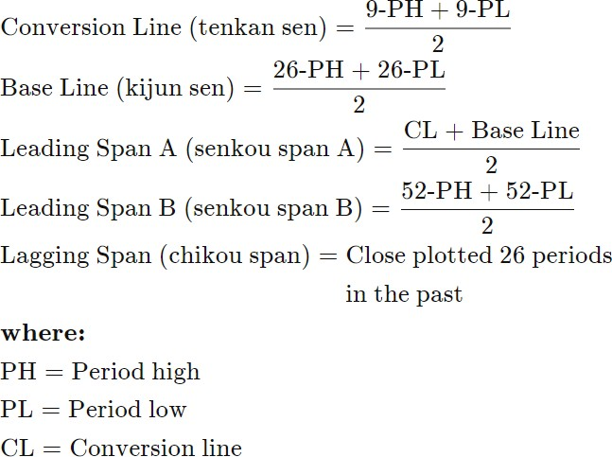
Ichimoku Cloud …
Notes:
Conversion line: highest high و lowest low رو در 9 روز گذشته پیدا میکنیم و میانگین میگیریم.
بعدیا هم به همین ترتیب و 5 خط پیدا میکنیم. این 5 خط به عنوان حمایت‌ها و مقاومت‌ها عمل میکنند.

Slide 43
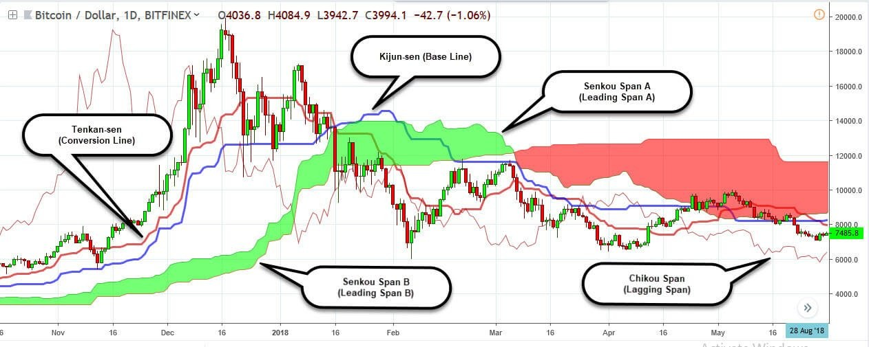
Ichimoku Cloud …

Slide 44
Ichimoku Cloud …
The overall trend is up when the price is above the cloud, down when the price is below the cloud, and trendless or transitioning when the price is in the cloud.
When Leading Span A is rising and above Leading Span B, this helps to confirm the uptrend and the space between the lines is typically colored green.
When Leading Span A is falling and below Leading Span B, this helps confirm the downtrend. The space between the lines is typically colored red in this case.
Traders will often use the Ichimoku Cloud as an area of support and resistance depending on the relative location of the price.
The cloud provides support/resistance levels that can be projected into the future.
This sets the Ichimoku Cloud apart from many other technical indicators that only provide support and resistance levels for the current date and time.
Notes:
اگر leading span A بالاتر از leading span B باشه، رنگ بینشون سبز میشه و uptrend رو تایید میکنه. در حالت بالعکس رنگ ابر قرمز میشه.
اگر CL بالاتر از Base line مثل movingها حالت صعودی رو نشون میده. اگر cross اتفاق بیفته حالت نزولی رو نشون میده.
- سیگنال‌های صعودی رو وقتی بالا ابر سبز هستیم در نظر میگیریم و سیگنال‌های نزولی رو وقتی پایین ابر قرمز هستیم در نظر میگیریم.
لبه‌های ابر و CL و BL مقاومت و حمایت هستند.
CL: conversion line
BL: base line

Slide 45
How to work with TradingView (practical part)
Charting facilities
Technical indicators
Paper trading
Developing new strategies using Pine script
Strategy backtesting

